Slide 1

Kaggle Credit Card Modeling
Prepared By: Syed Farhan Ahmed

Slide 2
Credit Card Dataset Understanding
Total number of clients in application dataset: 438557
Total number of unique clients in application dataset: 438510 Total number of clients in credit dataset: 1048575 Total number of unique clients in credit dataset: 45985 Common ID on both dataset assembles : 36457

Slide 3
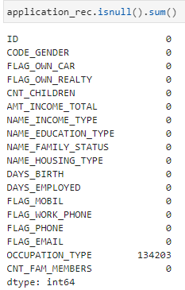
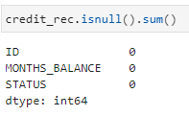
Credit Card Dataset Analysis
Checking Nulls, Duplicates and Outliers in the dataset Nulls – 134203 we need to remove this column Occupation_Type as it will create disturbance in the dataset while training and if we clean only values then dataset will get reduce. Duplicates – 47 Duplicates in application dataset and 1002590 duplicates in credit dataset

Slide 4
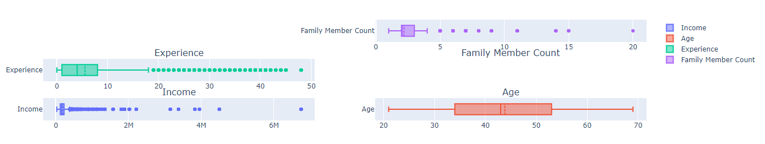
Credit Card Dataset Analysis
Checking Nulls, Duplicates and Outliers in the dataset Outliers – As it can be seen experience, income, family member shows some outliers which we plot through Box plot.

Slide 5
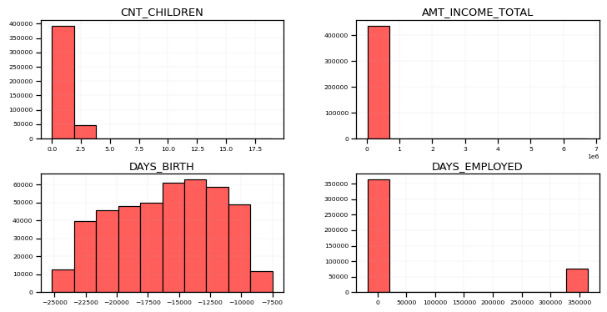
Credit Card Dataset Analysis
Visualizing some key features with respect to histogram through matplotlib library

Slide 6
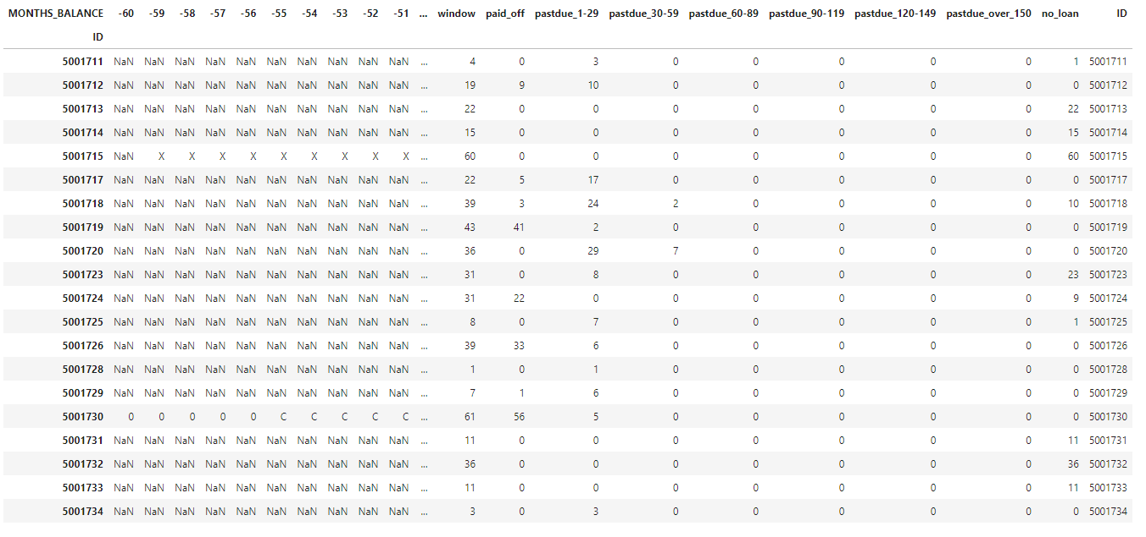
Credit Card Dataset Analysis
Applying Vintage analysis to identify the window of days of application which got Approved and Rejected As we analyze length of time since initial approval of credit card which is 60days through by getting min and max of opening month balances. So it means if any customer is delaying more than 60days will automatically rejected.

Slide 7

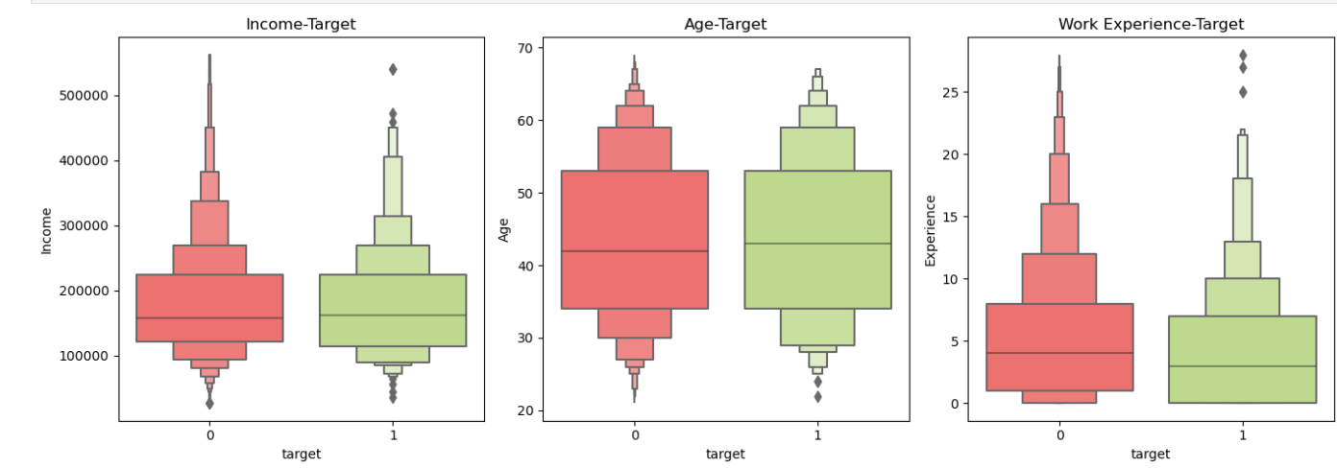
Credit Card Dataset Analysis
Now Doing couple of steps like below to get start with model training. - Feature Engineering - Fixing Imbalance Data set with SMOTE(library) - Feature Correlation with Seaborn Library - Calculating Information Value for dependencies on independent and dependent variables - Feature Scaling - RFE (Recursive Feature Elimination) for Feature Selection

Slide 8
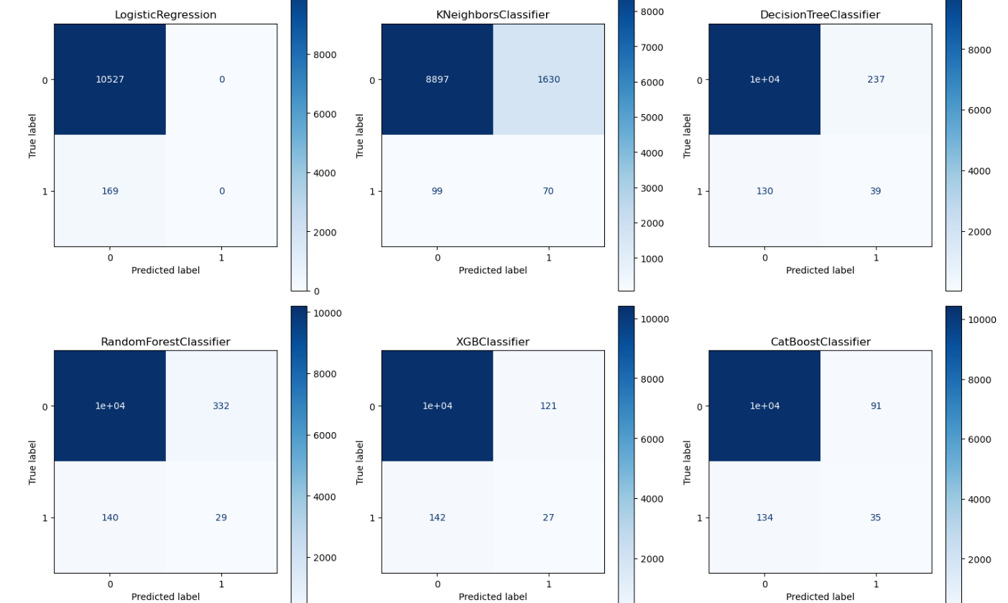
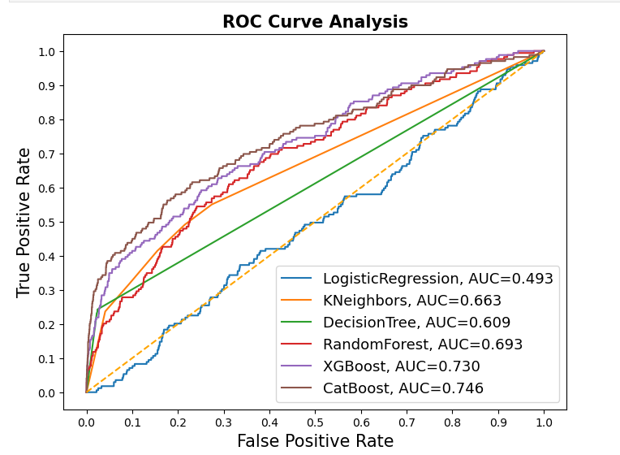
Modeling
Now Doing couple of steps like below to get start with model training. - Producing model training on multiple classifiers like Logistic Regression, Decision Trees, KNN, XGBoost, CatBoost, RandomForest. - Did training on 25K dataset (where training split was 70% and Testing 30%) - Also performed classification matric for identifying accuracy, recall, precision,f1score - Achieved highest accuracy with Logistic Regression 98.42%

Slide 9
Result
Here we can see that a lot of preprocessing and data cleansing has been done to acquire good accuracy I have tried multi model technique to see if we are getting better accuracy other than logisitic. But Since Logisitic is transparent because it understand the coefficient of feature which further predict the class of target variable. - Achieved highest accuracy with Logistic Regression 98.42%

